Slide 1

Project Proposal
Presentation

Slide 2


Introduction
The current transport systems face challenges like outdated infrastructure, safety concerns, and inefficient scheduling. Our project aims to integrate GPS and SIM-based technologies to address these issues. This system will provide real-time tracking, accurate arrival updates, and improved safety. It will also optimize routes, reduce delays, and minimize energy wastage.

Slide 3
OBJEctives/Goals/Outcomes
This project improves transport reliability using GPS tracking and SIM-based communication for real-time tracking and arrival notifications.
Develop a smart train system that:
Enhances safety with manual/automatic control and object distance detection.
Provides passengers with real-time location tracking, seat booking, and feedback options.
Ensures connectivity using Wi-Fi for live updates and services.
Impact:
Smarter, safer, and more efficient transport for passengers and operators.

Slide 4
WHAt?
Current problems in our transport system :
  Unreliable Transport: Frequent delay and increase costs.
  Inefficient Systems: No real-time updates, SMS alerts, or remote emergency controls like stopping a train.
  Lack of Live Tracking: Damaged vehicles/trains can’t be easily located, delaying assistance.
  Energy & Safety Risks: Inefficiencies waste energy and passenger safety .
Our solution: We are developing a next-generation transport system with real-time location tracking and SMS-based controls. It will provide live updates, notify users of delays and seating availability, and enable remote emergency actions.

Slide 5
Why This Project? Addressing Critical Transport Challenges
🚆 Outdated Infrastructure
Pakistan’s rail accidents are largely due to faulty tracks, outdated signals, and poor maintenance. Integrating GPS and SIM-based systems allows real-time monitoring of train locations and track conditions, preventing derailments and collisions. Automated alerts for track defects or misaligned switches enable proactive safety measures before accidents occur.
⚠️ Safety Concerns
Human errors—like miscommunication and incorrect signaling—are major causes of accidents. GPS and automated SIM-based communication ensure accurate, real-time coordination between trains and control centers, reducing signal errors and unsafe operations for a safer rail network.

Slide 6
📅 Inefficient Scheduling & Routing
Poor scheduling leads to train collisions and near-misses. With GPS-based real-time tracking, trains can be precisely monitored, preventing multiple trains from occupying the same track segment. This reduces congestion, improves efficiency, and minimizes accident risks.
🌍 Environmental Impact
Delays and mismanagement cause excessive fuel consumption and emissions. By optimizing routes and schedules, real-time tracking helps reduce unnecessary stops and idling, lowering energy waste and making rail transport more eco-friendly.

Slide 7
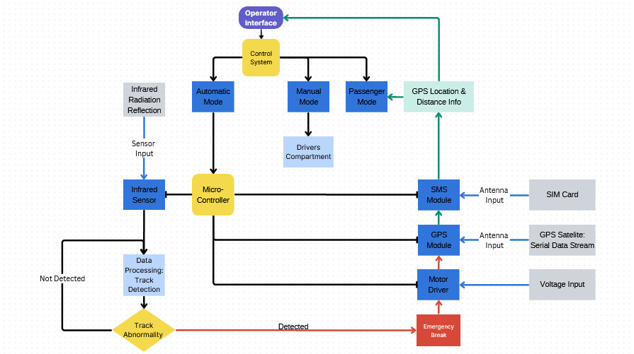
HOW?
Block diagram

Slide 8
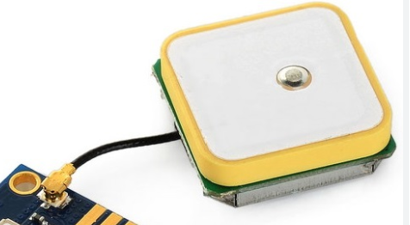
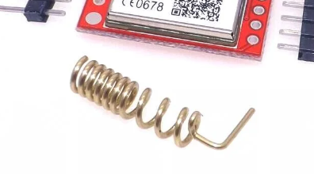
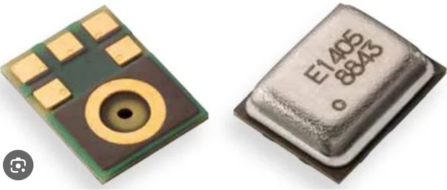
COMPONENTS
INPUT

Slide 9
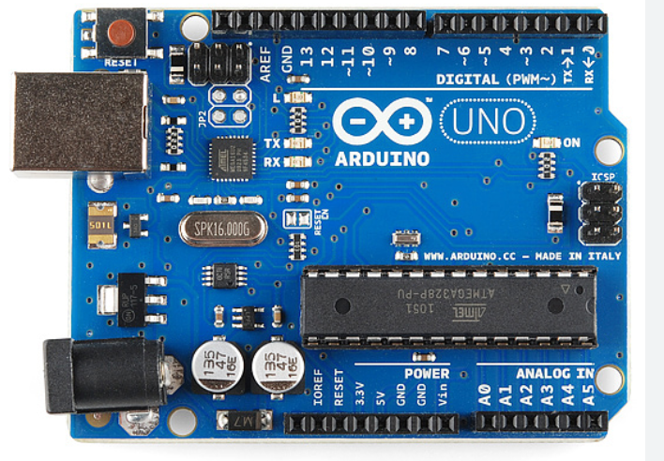
CONTROL

Slide 10
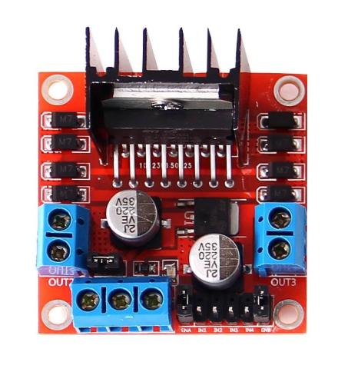
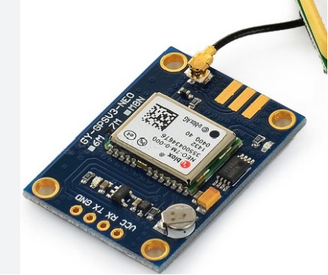
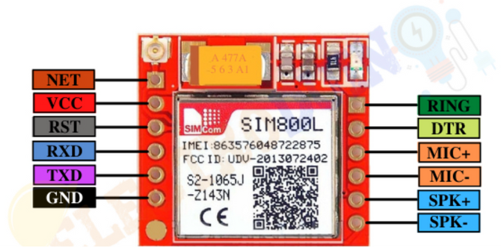
OUTPUT

Slide 11
Teams
For Software
For SMS MODULE
JAWAD
ATTA
ABDULLAH
FAHAD
For GPS MODULE
For Hardware
ISMAIL
TARIQ
HAMZAH
ROHAN

